Slide 1
Collections
Sunita Jain

Slide 2
Introducing Collection
Collection
Collections are the standard-way to store and manipulate group of elements(primitive values or objects)
Collections are internally objects of specific ‘collection classes’ such as List, Dictionary, SortedList etc.
[0]
Value0
[1]
Value1
[2]
Value2
[3]
Value3
[4]
Value4
List Collection- Example
List <type> referneceVariable=new List<type>();

Slide 3
Understanding Collections
Collections can store unlimited elements.
You can add/remove elements any time
You need not specify the size while creating collections.
You can search,sort,copy collections using various built-in methods.

Slide 4
List Collection
Collection
List collection contains a group of elements of same type
Full path: System.Collection.Generic.List;
The “List” is a Generic collection class; so you need to specify data type of value while creating object.
[0]
Value0
[1]
Value1
[2]
Value2
[3]
Value3
[4]
Value4
List Collection- Example
List <type> referneceVariable=new List<type>();

Slide 5
List
It is dynamically sized. You can add, remove elements at any time.
It allows duplicate values.
It is Index-based. You need to access elements by using zero-based Index.
It is not sorted by default. The elements are sorted in same order how they are initialized.
It used array internally; that means, recreates array when the elements are added or removed.
The ‘Capacity’ property holds the number of elements that can be stored
In the internal array of the list. If you add more elements, the
internal array will be resized to the ‘count’ of elements.

Slide 6
Properties & Methods of List Class
Properties:
Count
Capacity
Methods
Add(T)
AddRange(IEnuberable<T>)
Insert(int,T)
InsertRange(int, IEnuberable<T>)
Remove(int)
RemoveAt(int)
RemoveRange(int,int)
RemoveAll(Predicate<T>)
Clear

Slide 7
Properties & Methods of List Class
Sort()
Reverse()
ToArray()
ForEach(Action <T>)
Exists(Predicate<T>)
Find(Predicate<T>)
FindIndex(Predicate<T>)
FindLast(Predicate<T>)
FindLastIndex(Predicate<T>)
FindAll(Predicate<T>)
ConvertAll(T)

Slide 8
Dictionary
Collection
Dictionary collection contains a group of elements of key/value pairs.
The "Dictionary" class is a generic class; so you need to specify data type of the key and data type of the value while creating object
You can set / get the value based on the key
The key can't be null or duplicate
[Key 0]
Value0
[Key 1]
Value1
Value2
[Key 2]
[Key 3]
Value3
[Key 4]
Value4
Dictionary Collection- Example
Dictionary<Tkey,Tvalue> referenceVariable = new Dictionary <Tkey,Tvalue>( );

Slide 9
Dictionary
It is dynamically sized. You can add, remove elements (key/value pairs) at any time
Key can't be null or duplicate; but value can be null or duplicate.
It is not index-based. You need to access elements by using key.
It is not sorted by default. The elements are stored in the same order, how they are initialized.

Slide 10
Properties & Methods of Dictionary Class
Properties:
Count :Returns count of elements
[TKey] : Returns value based on specified key
Keys : Returns a collection of key (without values)
Values : Returns a collection of values (without keys)
Methods
void Add(TKey, TValue): Adds an element (key/value pair).
bool Remove(TKey) : Removes an element based on specified key
bool ContainsKey(Tkey):Determines whether the specified key exists.
bool ContainsValue(TValue):Determines whether the specified value exists.
void Clear():Removes all elements.

Slide 11
SortedList
Collection
SortedList collection contains a group of elements of key/value pairs.
The "SortedList" class is a generic class; so you need to specify data type of the key and data type of the value while creating object.
You can set / get the value based on the key
The key can't be null or duplicate
[Key 0]
Value0
Value1
[Key 1]
Value2
[Key 2]
[Key 3]
Value3
[Key 4]
Value4
SortedList Collection- Example
SortedList<Tkey,Tvalue> referenceVariable = new SortedList <Tkey,Tvalue>( );

Slide 12
SortedList
It is dynamically sized. You can add, remove elements (key/value pairs) at any time.
Key can't be null or duplicate; but value can be null or duplicate.
It is not index-based. You need to access elements by using key.
It is sorted by default. The elements are stored in the sorted ascending order, according to the key.
Each operation of adding element, removing element or any other operation might be slower than Dictionary, because internally it resorts the data based on key.

Slide 13
Properties & Methods of SortedList Class
Properties:
Count :Returns count of elements
[TKey] : Returns value based on specified key
Keys : Returns a collection of key (without values)
Values : Returns a collection of values (without keys)
Methods
void Add(TKey, TValue): Adds an element (key/value pair).
bool Remove(TKey) : Removes an element based on specified key
bool ContainsKey(Tkey):Determines whether the specified key exists.
bool ContainsValue(TValue):Determines whether the specified value exists.
void Clear():Removes all elements.
int IndexOfKey(TKey):Returns index of the specified key.
int IndexOfValue(TValue):Returns index of the specified value.

Slide 14


Collection Hierarchy
interface IEnumerator<T>

Slide 15
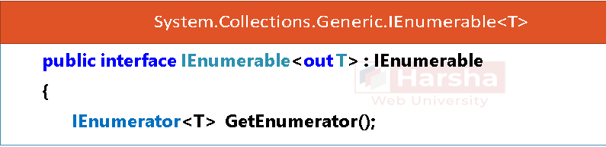
IEnumerable
The IEnumerable interface represents a group of elements.
It is the parent interface of all types of collections.
It is the parent of ICollection interface, which is implemented by other interfaces such as IList, IDictionary etc.

Slide 16
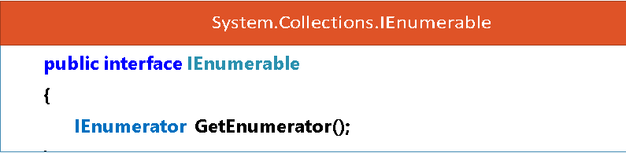
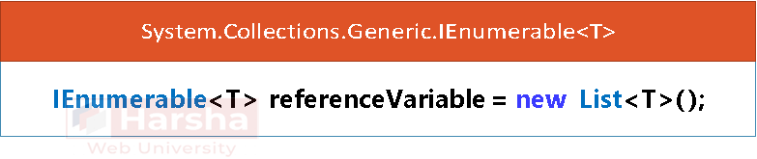
IEnumerable
System.Collections.IEnumerable
IEnumerable referenceVariable = new ArrayList( );

Slide 17
IEnumerator
The IEnumerator interface is meant for readonly and sequential navigation of group of elements.
IEnumerator is used by foreach loop internally.
IEnumerable interface has a method called GetEnumerator that returns an instance of IEnumerator.
IEnumerator by default starts with first element; MoveNext( ) method reads the next element; and the "Current" property returns the current element based on the current position.

Slide 18
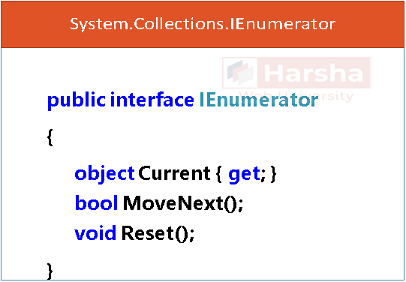
IEnumerator
System.Collections.Generic.IEnumerator<T>
public interface IEnumerator<out T> : IDisposable, IEnumerator
{
T Current { get; }
}

Slide 19
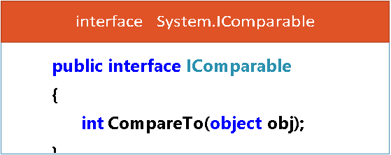
IComparable
The System.Icomparable interface has a method called "CompareTo",which determines order of two objects i.e. current object and parameter object.
It can be implemented in the class to make the objects sortable.
It is useful to invoke List.Sort method to sort the collection of objects.
Return Value of ComapreTo Method:
0 : "this" object and parameter object occur in the same position(unchanged)
<0: "this" object comes first; parameter object comes next.
>0: parameter object comes first; "this" object comes next.

